Slide 1


Public Health Division
Community Traffic Safety Coalition
2014-2023 Crash Report
Kelly Curlett, MPH
Safe and Active Transportation Health Educator
August 2025

Slide 2

Community Traffic Safety Coalition
Vision: Safe, accessible, and
equitable transportation for all.
Mission: Prevent traffic-related injuries
and fatalities for all road users in Santa
Cruz County, with a focus on people
bicycling and walking.

Slide 3
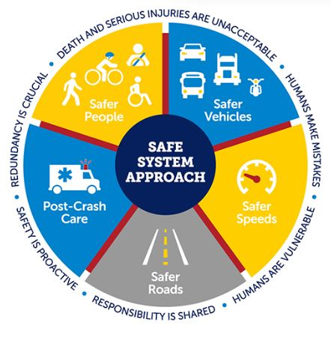

Vision Zero & The Safe System Approach
International policy that aims to eliminate all traffic fatalities and severe injuries while increasing safe, healthy, and equitable mobility for all.
Utilizes the Safe System Approach which evaluates our roadway safety from a systems-level perspective.

Slide 4
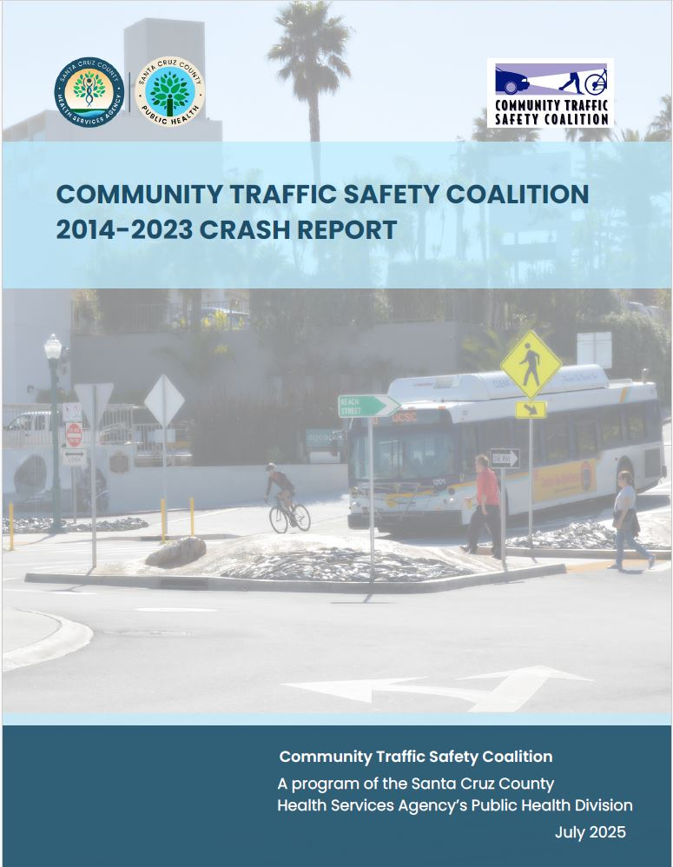

2014-2023 Crash Report: Purpose
Raise awareness of fatal and serious injury crashes to prioritize traffic safety and reinforce the need for street design and policy changes
Change the cultural perception that traffic fatalities and serious injuries are random, inevitable “accidents” to preventable, avoidable “crashes”
unavoidable
preventable

Slide 5
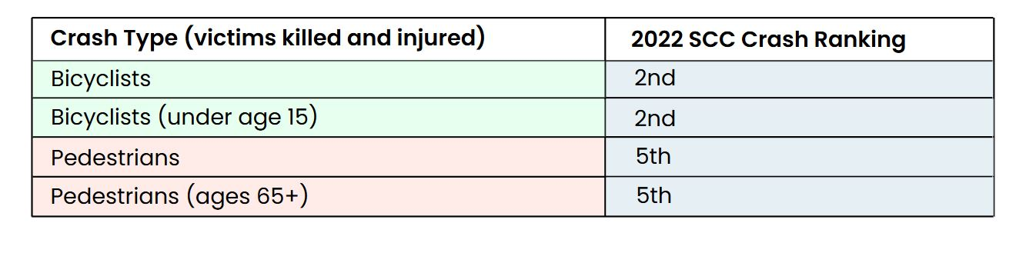
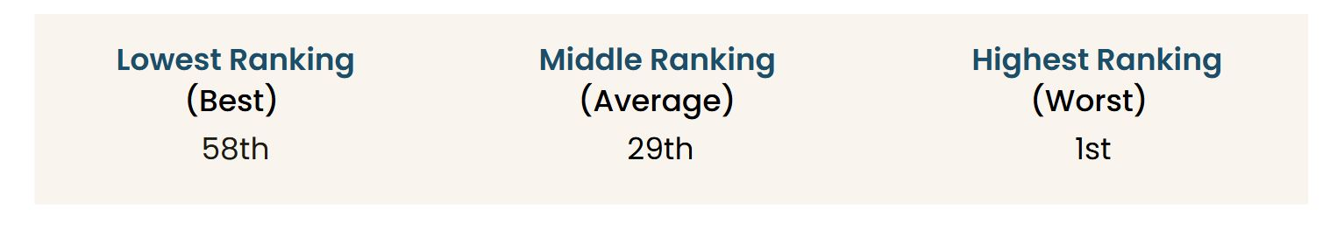
2022 Statewide OTS CRASH RANKINGS
Santa Cruz County ranked 11th highest (or worst) of all 58 counties in the state for total victims killed and injured in traffic collisions.
Ranked in top 10 for the crash categories below:

Slide 6
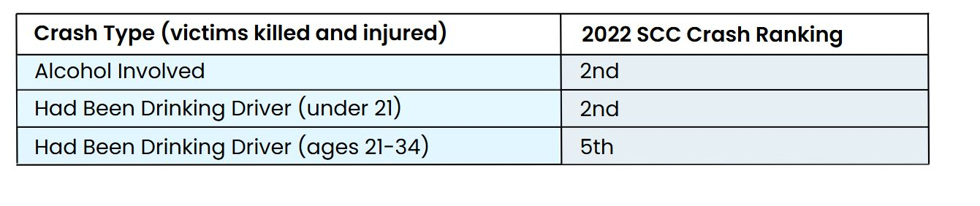
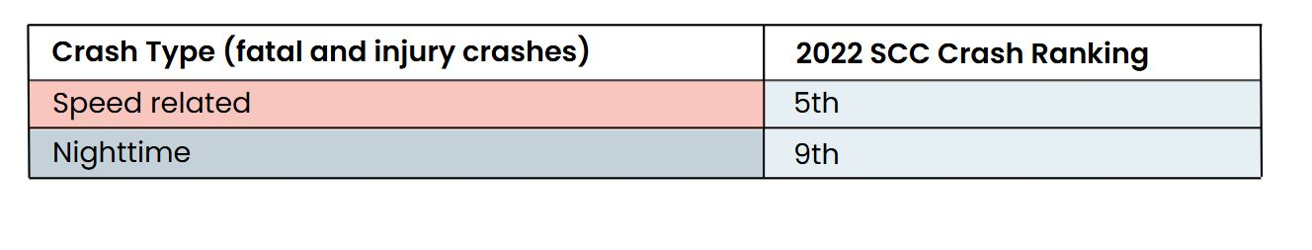
2022 Statewide OTS CRASH RANKINGS

Slide 7
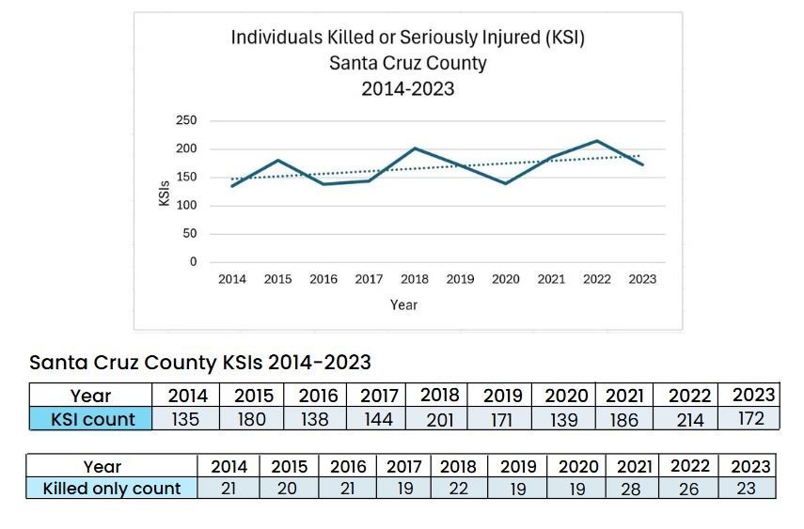
Santa Cruz County Crash Overview (2014-2023)
Totals
Reported crashes: 11,637
Killed or Serious Injury (KSI) Crashes: 1,497
Fatalities: 224
Serious Injuries: 1,456

Slide 8
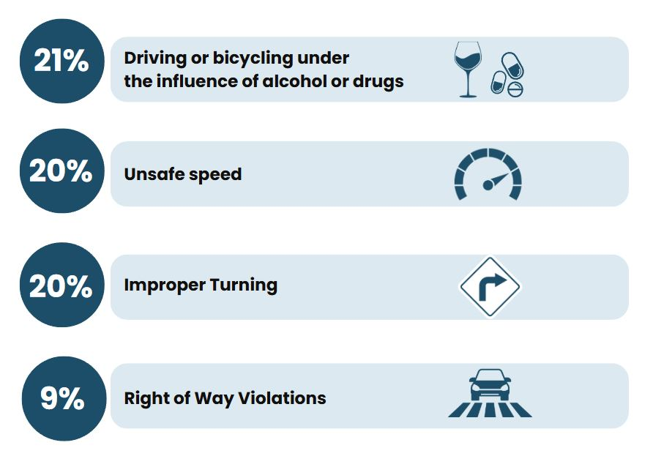
Top primary collision factor violations for KSI crashes:

Slide 9
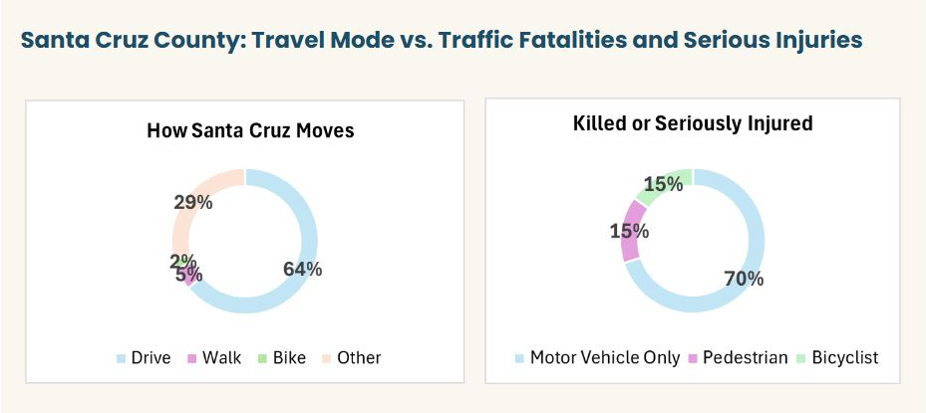
Bicycle and Pedestrian Crashes

Slide 10
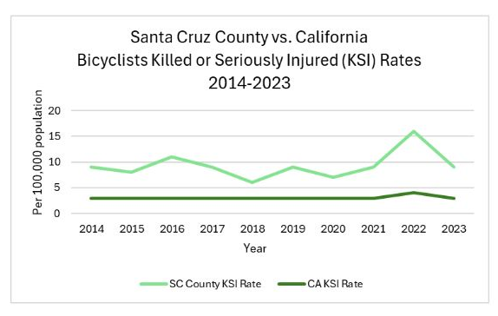
Bicycle Crashes
Totals:
Killed: 12
Seriously Injured: 242
Average Santa Cruz County bicyclist KSI crash rate was 3X higher than the state bicyclist KSI crash rate
Notes:
Note: Title of the Chart should be the title of the Slide.
Please install the font, Poppins:
https://fonts.google.com/specimen/Poppins

Slide 11
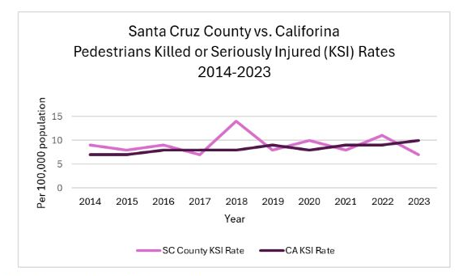
Pedestrian Crashes
Totals:
Killed: 65
Seriously Injured: 188
Higher rates compared to the state for most years, with greatest difference in 2018
Notes:
Note: Title of the Chart should be the title of the Slide.
Please install the font, Poppins:
https://fonts.google.com/specimen/Poppins

Slide 12
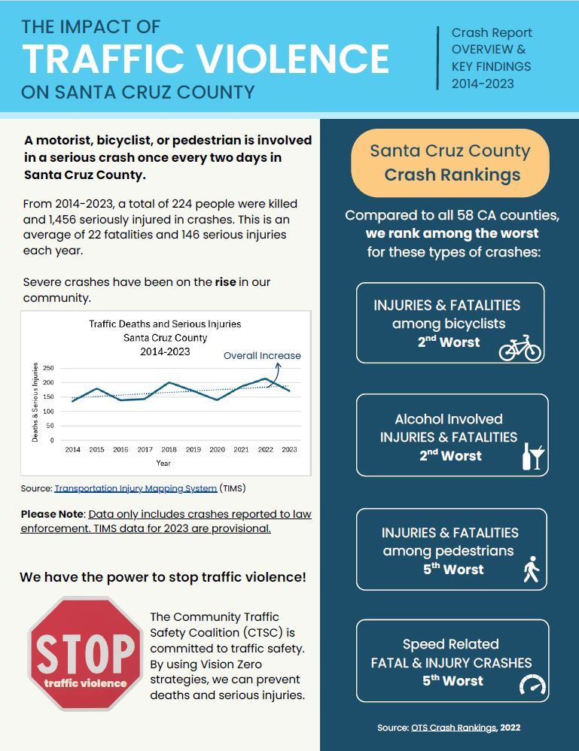
2014-2023 Crash Report
The Impact of Traffic Violence on Santa Cruz County (English, Spanish)

Slide 13
References:
California Office of Traffic Safety
https://www.ots.ca.gov/media-and-research/crash-rankings/
Transportation Information Mapping System
https://tims.berkeley.edu/tools/query/summary.php
United States Census Bureau, American Community Survey Reports (2018-2021)
https://www.census.gov/programs-surveys/acs
United States Census Bureau
census.gov

Slide 14
Community Resources:
OTS “Go Safely, California” educational program: gosafelyca.org
Commuter traffic education and workshops: gosantacruzcounty.org
Active transportation programs and safety resources: letsmodo.org
Santa Cruz County’s Bicycle Traffic School program: sctrafficsafety.org
Grief and trauma resources: familiesforsafestreets.org/national-resource-guide
E-bike Safety Handouts: santacruz.bcycle.com/nav/safe-biking-practices

Slide 15
Questions?
Thank You
Email: ctsc@santacruzcounty.us
Phone: 831-454-7551
Website: sctrafficsafety.org
Facebook and Instagram: sctrafficsafety

